Slide 1
Improving Generative Adversarial Network (GAN)
Hung-yi Lee
Notes:
http://dalimeeting.org/dali2017/generative-adversarial-networks.html
Not mention (energy-based):
BE GAN
Gang of GANs: Generative Adversarial Networks with Maximum Margin Ranking
MAGAN: Margin Adaptation for Generative Adversarial Networks
MIX+GAN (Generalization and Equilibrium in Generative Adversarial Nets (GANs)
)

Slide 2
Outline
Generation
Basic Idea
(Review)
Unified
Framework
Paired
Data
WGAN
Unpaired
Data
Energy-based
GAN
Evaluation
Transformation
(next time)
Notes:
Overview
F-div
Improved W-GAN
W-GAN
Evaluation

Slide 3
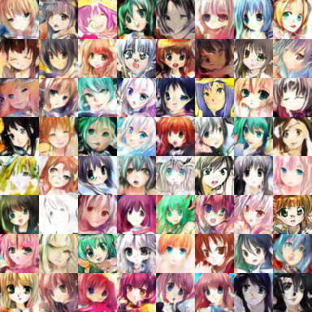












Generation
Using Generative Adversarial Network (GAN)
Drawing?

Slide 4
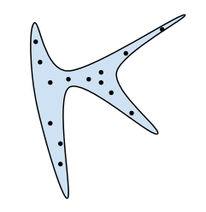
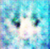
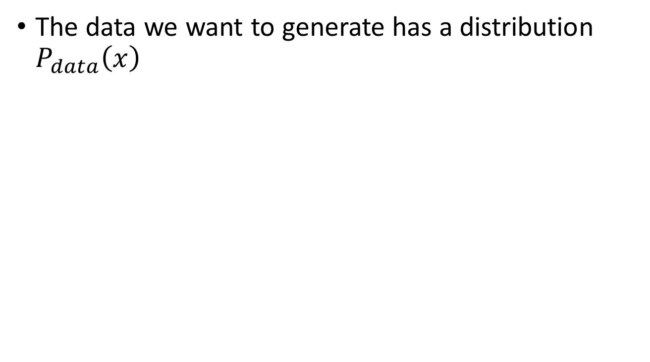

Basic Idea of GAN
The data we want to generate has a distribution $P_{data}\left(x\right)$
$$P_{data}\left(x\right)$$
High
Probability
Low
Probability
Image
Space

Slide 5



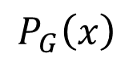
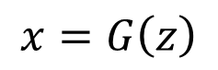
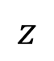
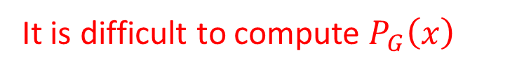
Basic Idea of GAN
A generator G is a network. The network defines a probability distribution.
$$P_{G}\left(x\right)$$
$$P_{data}\left(x\right)$$
Normal Distribution
generator
G
$$z$$
$$x=G\left(z\right)$$
As close as possible
It is difficult to compute $P_{G}\left(x\right)$
We can only sample from the distribution.
https://blog.openai.com/generative-models/

Slide 6
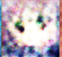
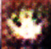
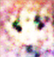
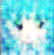
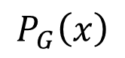

Basic Idea of GAN
Normal Distribution
$$P_{G}\left(x\right)$$
NN
Generator
v1
0
0
0
0
$$P_{data}\left(x\right)$$
1
1
1
1
image
Discri-minatory
v1
It can be proofed that the loss of the discriminator related to JS divergence.
1/0

Slide 7




Basic Idea of GAN
Normal Distribution
$$P_{G}\left(x\right)$$
NN
Generator
v1
v2
1
1
1
0
0
0
0
1
0
0
0
0
$$P_{data}\left(x\right)$$
1
1
1
1
image
Discri-minatory
v1
It can be proofed that the loss the discriminator related to JS divergence.
1/0
v2

Slide 8
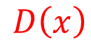
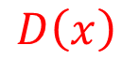
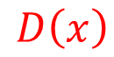
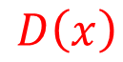
Intuition
Discriminator
Data (target) distribution
Generated distribution
Discriminator leads the generator
$$D\left(x\right)$$
$$D\left(x\right)$$
$$D\left(x\right)$$
$$D\left(x\right)$$

Slide 9
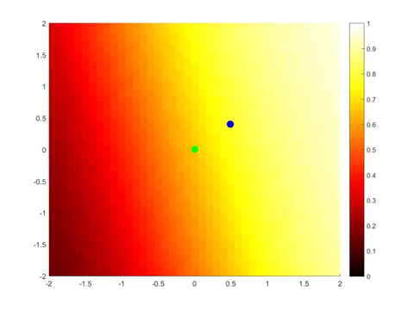
Original GAN
The discriminator is flat in the end.
Source: https://www.youtube.com/watch?v=ebMei6bYeWw (credit: Benjamin Striner)

Slide 10
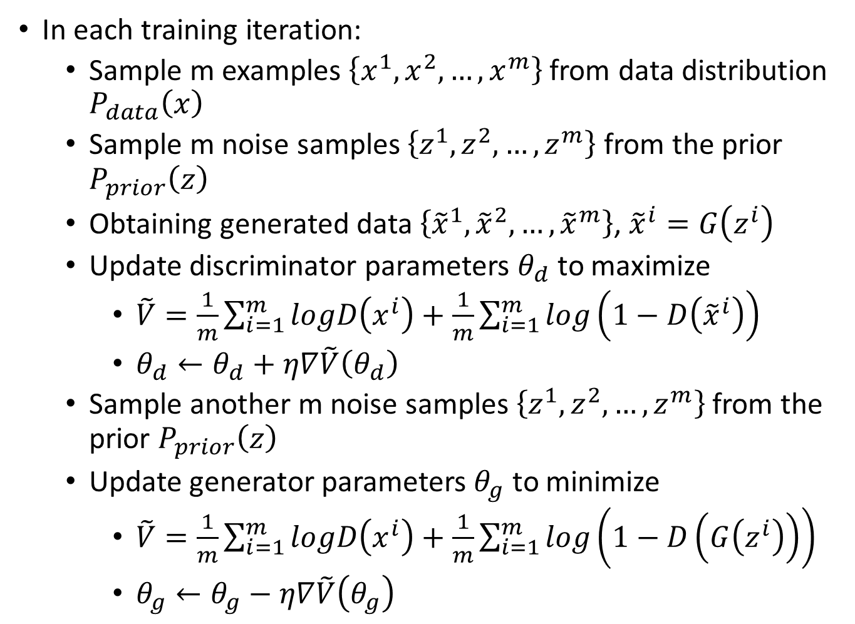
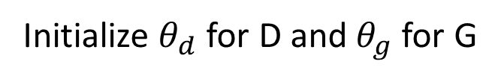
Algorithm
Initialize $θ_{d}$ for D and $θ_{g}$ for G
In each training iteration:
Sample m examples $\left\{x^{1},x^{2},…,x^{m}\right\}$ from data distribution $P_{data}\left(x\right)$
Sample m noise samples $\left\{z^{1},z^{2},…,z^{m}\right\}$ from the prior $P_{prior}\left(z\right)$
Obtaining generated data $\left\{{\tilde{x}}^{1},{\tilde{x}}^{2},…,{\tilde{x}}^{m}\right\}$, ${\tilde{x}}^{i}=G\left(z^{i}\right)$
Update discriminator parameters $θ_{d}$ to maximize
$\tilde{V}=\frac{1}{m}\sum_{i=1}^{m}{logD\left(x^{i}\right)}+\frac{1}{m}\sum_{i=1}^{m}{log\left(1−D\left({\tilde{x}}^{i}\right)\right)}$
$θ_{d}←θ_{d}+η∇\tilde{V}\left(θ_{d}\right)$
Sample another m noise samples $\left\{z^{1},z^{2},…,z^{m}\right\}$ from the prior $P_{prior}\left(z\right)$
Update generator parameters $θ_{g}$ to minimize
$\tilde{V}=\frac{1}{m}\sum_{i=1}^{m}{logD\left(x^{i}\right)}+\frac{1}{m}\sum_{i=1}^{m}{log\left(1−D\left(G\left(z^{i}\right)\right)\right)}$
$θ_{g}←θ_{g}−η∇\tilde{V}\left(θ_{g}\right)$
Learning
D
Repeat k times
Learning
G
Only Once
Notes:
位什麼要 1- 啊

Slide 11
Outline
Generation
Basic Idea
(Review)
f-divergence
Fenchel Conjugate
Connect to GAN
Unified
Framework
Paired
Data
WGAN
Unpaired
Data
Energy-based
GAN
Evaluation
Transformation
(next time)
Notes:
Original GAN using binary classifier to evaluate JS divergence of two distributions
Actually, we can evaluate any f-divergence.

Slide 12
Reference
Sebastian Nowozin, Botond Cseke, Ryota Tomioka, “f-GAN: Training Generative Neural Samplers using Variational Divergence Minimization”, NIPS, 2016
One sentence: you can use any f-divergence

Slide 13
Outline
Generation
Basic Idea
(Review)
f-divergence
Fenchel Conjugate
Connect to GAN
Unified
Framework
Paired
Data
WGAN
Unpaired
Data
Energy-based
GAN
Evaluation
Transformation
(next time)
Notes:
Original GAN using binary classifier to evaluate JS divergence of two distributions
Actually, we can evaluate any f-divergence.

Slide 14
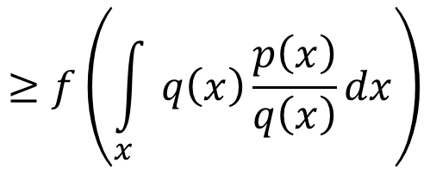
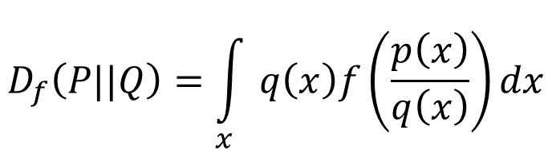
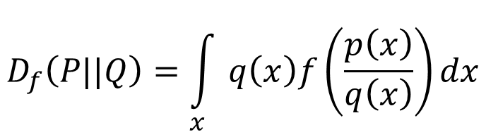
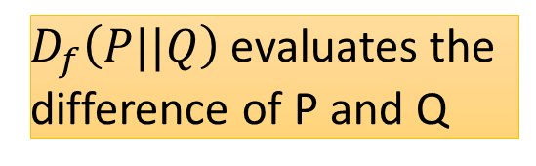
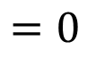
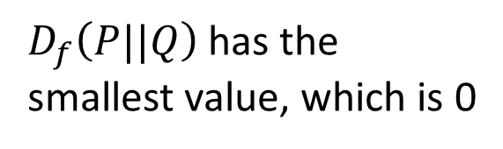
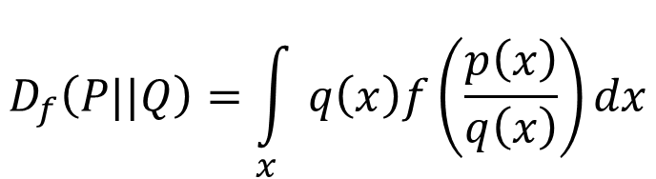
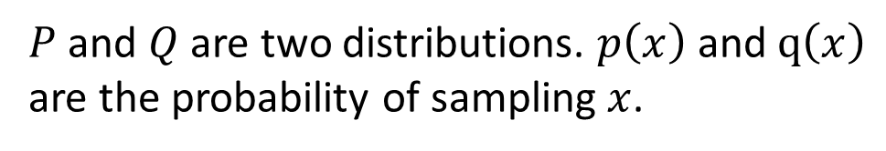
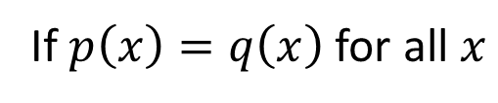
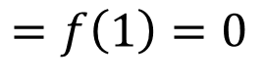
f-divergence
$P$ and $Q$ are two distributions. $p\left(x\right)$ and $q\left(x\right)$ are the probability of sampling $x$.
$$D_{f}\left(P||Q\right)=\int_{x}{q\left(x\right)f\left(\frac{p\left(x\right)}{q\left(x\right)}\right)dx}$$
f is convex
$D_{f}\left(P||Q\right)$ evaluates the difference of P and Q
f(1) = 0
If $p\left(x\right)=q\left(x\right)$ for all $x$
= 1
$$D_{f}\left(P||Q\right)=\int_{x}{q\left(x\right)f\left(\frac{p\left(x\right)}{q\left(x\right)}\right)dx}$$
smallest
$$=0$$
$$D_{f}\left(P||Q\right)=\int_{x}{q\left(x\right)f\left(\frac{p\left(x\right)}{q\left(x\right)}\right)dx}$$
= 0
If P and Q are the same distributions,
$$≥f\left(\int_{x}{q\left(x\right)\frac{p\left(x\right)}{q\left(x\right)}dx}\right)$$
Because f is convex
$D_{f}\left(P||Q\right)$ has the smallest value, which is 0
$$=f\left(1\right)=0$$
Notes:
The constraint of f is for non-negative
http://www.stat.berkeley.edu/~aditya/resources/STAT212aOverview.pdf

Slide 15
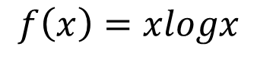
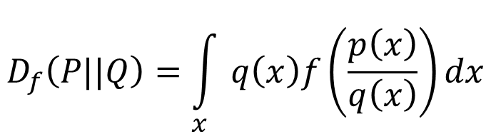
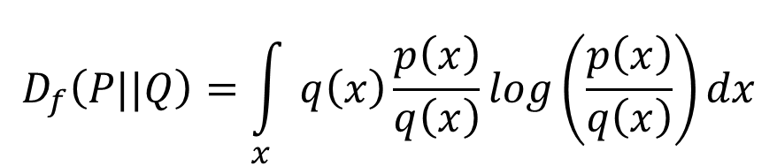
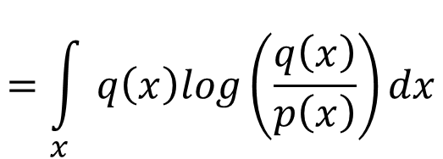
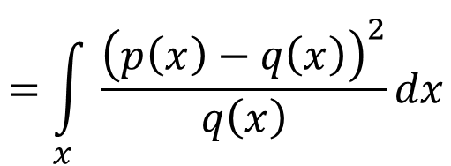
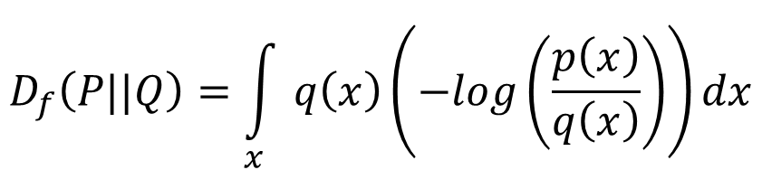
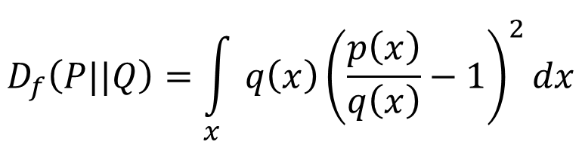
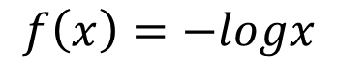
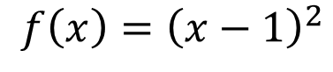
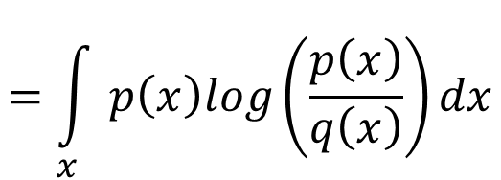
f-divergence
$$D_{f}\left(P||Q\right)=\int_{x}{q\left(x\right)f\left(\frac{p\left(x\right)}{q\left(x\right)}\right)dx}$$
f is convex
f(1) = 0
$$f\left(x\right)=xlogx$$
KL
$$D_{f}\left(P||Q\right)=\int_{x}{q\left(x\right)\frac{p\left(x\right)}{q\left(x\right)}log\left(\frac{p\left(x\right)}{q\left(x\right)}\right)dx}$$
$$=\int_{x}{p\left(x\right)log\left(\frac{p\left(x\right)}{q\left(x\right)}\right)dx}$$
$$f\left(x\right)=−logx$$
Reverse KL
$$D_{f}\left(P||Q\right)=\int_{x}{q\left(x\right)\left(−log\left(\frac{p\left(x\right)}{q\left(x\right)}\right)\right)dx}$$
$$=\int_{x}{q\left(x\right)log\left(\frac{q\left(x\right)}{p\left(x\right)}\right)dx}$$
$$f\left(x\right)={\left(x−1\right)}^{2}$$
Chi Square
$$D_{f}\left(P||Q\right)=\int_{x}{q\left(x\right){\left(\frac{p\left(x\right)}{q\left(x\right)}−1\right)}^{2}dx}$$
$$=\int_{x}{\frac{{\left(p\left(x\right)−q\left(x\right)\right)}^{2}}{q\left(x\right)}dx}$$
Notes:
The constraint of f is for non-negative
http://www.stat.berkeley.edu/~aditya/resources/STAT212aOverview.pdf

Slide 16
Outline
Generation
Basic Idea
(Review)
f-divergence
Fenchel Conjugate
Connect to GAN
Unified
Framework
Paired
Data
WGAN
Unpaired
Data
Energy-based
GAN
Evaluation
Transformation
(next time)
Notes:
Original GAN using binary classifier to evaluate JS divergence of two distributions
Actually, we can evaluate any f-divergence.

Slide 17
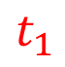
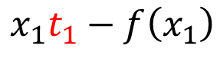
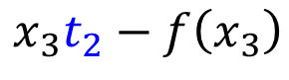
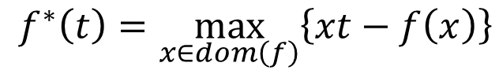
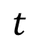
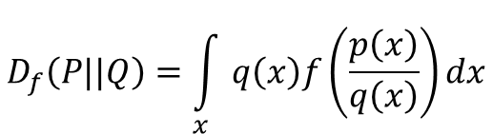
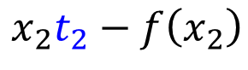

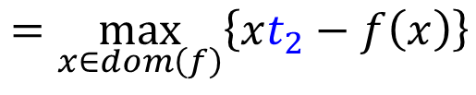
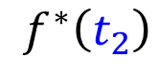

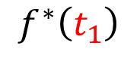





Fenchel Conjugate
$$D_{f}\left(P||Q\right)=\int_{x}{q\left(x\right)f\left(\frac{p\left(x\right)}{q\left(x\right)}\right)dx}$$
f is convex, f(1) = 0
Every convex function f has a conjugate function f*
$$f^{∗}\left(t\right)=\max_{x∈dom\left(f\right)}\left\{xt−f\left(x\right)\right\}$$
$$f^{∗}\left(t_{1}\right)$$
$$=\max_{x∈dom\left(f\right)}\left\{xt_{1}−f\left(x\right)\right\}$$
$$x_{1}t_{1}−f\left(x_{1}\right)$$
$$f^{∗}\left(t_{1}\right)$$
$$f^{∗}\left(t_{2}\right)$$
$$=\max_{x∈dom\left(f\right)}\left\{xt_{2}−f\left(x\right)\right\}$$
$$x_{3}t_{2}−f\left(x_{3}\right)$$
$$f^{∗}\left(t_{2}\right)$$
$$x_{2}t_{1}−f\left(x_{2}\right)$$
$$x_{2}t_{2}−f\left(x_{2}\right)$$
$$x_{3}t_{1}−f\left(x_{3}\right)$$
$$x_{1}t_{2}−f\left(x_{1}\right)$$
$$t_{1}$$
$$t_{2}$$
$$t$$
Notes:
supernum 最小上界
http://www.seas.ucla.edu/~vandenbe/236C/lectures/conj.pdf
Proof at here: http://www.control.lth.se/media/Education/DoctorateProgram/2015/LargeScaleConvexOptimization/Lectures/conj_fcn.pdf

Slide 18






Fenchel Conjugate
$$D_{f}\left(P||Q\right)=\int_{x}{q\left(x\right)f\left(\frac{p\left(x\right)}{q\left(x\right)}\right)dx}$$
f is convex, f(1) = 0
Every convex function f has a conjugate function f*
$$f^{∗}\left(t\right)=\max_{x∈dom\left(f\right)}\left\{xt−f\left(x\right)\right\}$$
$$x_{1}t−f\left(x_{1}\right)$$
$$f^{∗}\left(t_{1}\right)$$
$$f^{∗}\left(t_{2}\right)$$
$$x_{2}t−f\left(x_{2}\right)$$
$$x_{3}t−f\left(x_{3}\right)$$
$$t_{1}$$
$$t_{2}$$
$$t$$
Notes:
Fix x, t is variable
supernum 最小上界
http://www.seas.ucla.edu/~vandenbe/236C/lectures/conj.pdf
Proof at here: http://www.control.lth.se/media/Education/DoctorateProgram/2015/LargeScaleConvexOptimization/Lectures/conj_fcn.pdf

Slide 19





Fenchel Conjugate
Every convex function f has a conjugate function f*
$$f^{∗}\left(t\right)=\max_{x∈dom\left(f\right)}\left\{xt−f\left(x\right)\right\}$$
$$\text{10}\text{t}\text{ – 10 }\text{log}\text{ 10}$$
$$f\left(x\right)=xlogx$$
Something like exponential?
$$\text{1}\text{t}\text{ –1}\text{log}\text{1}$$
= 1t – 0
$$f^{∗}\left(t\right)=exp\left(t−1\right)$$
$$\text{0.1}\text{t}\text{ – 0.1}\text{log}\text{0.1}$$
Notes:
http://www.seas.ucla.edu/~vandenbe/236C/lectures/conj.pdf
0.1t - 0.1log0.1
1t – 0
10t – 10 log 10

Slide 20









Fenchel Conjugate
Every convex function f has a conjugate function f*
(f*)* = f
$$f^{∗}\left(t\right)=\max_{x∈dom\left(f\right)}\left\{xt−f\left(x\right)\right\}$$
$$f\left(x\right)=xlogx$$
$$f^{∗}\left(t\right)=exp\left(t−1\right)$$
$$f^{∗}\left(t\right)=\max_{x∈dom\left(f\right)}\left\{xt−xlogx\right\}$$
$$g\left(x\right)=xt−xlogx$$
Given t, find x maximizing $g\left(x\right)$
$$t−logx−1=0$$
$$x=exp\left(t−1\right)$$
$$f^{∗}\left(t\right)=exp\left(t−1\right)×t−exp\left(t−1\right)×\left(t−1\right)$$
$$=exp\left(t−1\right)$$
Notes:
http://www.seas.ucla.edu/~vandenbe/236C/lectures/conj.pdf

Slide 21
Outline
Generation
Basic Idea
(Review)
f-divergence
Fenchel Conjugate
Connect to GAN
Unified
Framework
Paired
Data
WGAN
Unpaired
Data
Energy-based
GAN
Evaluation
Transformation
(next time)
Notes:
Original GAN using binary classifier to evaluate JS divergence of two distributions
Actually, we can evaluate any f-divergence.

Slide 22










Connection with GAN
$$f^{∗}\left(t\right)=\sup_{x∈dom\left(f\right)}\left\{xt−f\left(x\right)\right\}$$
$$f\left(x\right)=\max_{t∈dom\left(f^{∗}\right)}\left\{xt−f^{∗}\left(t\right)\right\}$$
$$D_{f}\left(P||Q\right)=\int_{x}{q\left(x\right)f\left(\frac{p\left(x\right)}{q\left(x\right)}\right)dx}$$
$$\frac{p\left(x\right)}{q\left(x\right)}$$
$$\frac{p\left(x\right)}{q\left(x\right)}$$
$$=\int_{x}{q\left(x\right)\left(\max_{t∈dom\left(f^{∗}\right)}\left\{\frac{p\left(x\right)}{q\left(x\right)}t−f^{∗}\left(t\right)\right\}\right)dx}$$
$$≈\max_{D}{\int_{x}{p\left(x\right)D\left(x\right)dx−\int_{x}{q\left(x\right)f^{∗}\left(D\left(x\right)\right)dx}}}$$
$$D_{f}\left(P||Q\right)≥\int_{x}{q\left(x\right)\left(\frac{p\left(x\right)}{q\left(x\right)}D\left(x\right)−f^{∗}\left(D\left(x\right)\right)\right)dx}$$
$D$ is a function whose input is x, and output is t
$$=\int_{x}{p\left(x\right)D\left(x\right)dx−\int_{x}{q\left(x\right)f^{∗}\left(D\left(x\right)\right)dx}}$$
Notes:
最小上界
Imagine that there is a function $T\left(x\right)$ whose output is t

Slide 23





Connection with GAN
$$≈\max_{D}\int_{x}{p\left(x\right)D\left(x\right)dx−\int_{x}{q\left(x\right)f^{∗}\left(D\left(x\right)\right)dx}}$$
$$D_{f}\left(P||Q\right)$$
$$=\max_{D}\left\{E_{x\sim P}\left[D\left(x\right)\right]−E_{x\sim Q}\left[f^{∗}\left(D\left(x\right)\right)\right]\right\}$$
Samples from P
Samples from Q
$$D_{f}\left(P_{data}||P_{G}\right)$$
$$=\max_{D}\left\{E_{x\sim P_{data}}\left[D\left(x\right)\right]−E_{x\sim P_{G}}\left[f^{∗}\left(D\left(x\right)\right)\right]\right\}$$
Original GAN has different V(G,D)
$$G^{∗}=arg\min_{G}{D_{f}\left(P_{data}||P_{G}\right) }$$
$$=arg\min_{G}{\max_{D}\left\{E_{x\sim P_{data}}\left[D\left(x\right)\right]−E_{x\sim P_{G}}\left[f^{∗}\left(D\left(x\right)\right)\right]\right\}}$$
$$=arg\min_{G}{\max_{D}{V\left(G,D\right)}}$$
familiar? ☺

Slide 24



Double-loop v.s. Single-step
$$G^{∗}=arg\min_{G}{\max_{D}{V\left(G,D\right)}}$$
$$G^{∗}=arg\min_{θ_{G}}{\max_{θ_{D}}{V\left(θ_{G},θ_{D}\right)}}$$
Original paper of GAN: double-loop algorithm
In each iteration
Given a generator $θ_{G}^{t}$, $θ_{D}^{t}=arg\max_{θ_{D}}{V\left(θ_{G}^{t},θ_{D}\right)}$
Update the parameters many times to find $θ_{D}^{t}$
Update generator once:
$θ_{G}^{t+1}←θ_{G}^{t}−η∇_{θ_{G}}V\left(θ_{G}^{t},θ_{D}^{t}\right)$
Paper of f-GAN: Single-step algorithm
In each iteration, given $θ_{G}^{t}$ and $θ_{D}^{t}$
$θ_{D}^{t+1}←θ_{D}^{t}+η∇_{θ_{D}}V\left(θ_{G}^{t},θ_{D}^{t}\right)$
$θ_{G}^{t+1}←θ_{G}^{t}−η∇_{θ_{G}}V\left(θ_{G}^{t},θ_{D}^{t}\right)$
Inner Loop
Outer Loop
One Backpropogation
Notes:
One back propogation
It will converge

Slide 25



$$D_{f}\left(P_{data}||P_{G}\right)$$
$$=\max_{D}\left\{E_{x\sim P_{data}}\left[D\left(x\right)\right]−E_{x\sim P_{G}}\left[f^{∗}\left(D\left(x\right)\right)\right]\right\}$$
Using the f-divergence you like ☺
https://arxiv.org/pdf/1606.00709.pdf

Slide 26

Experimental Results
Approximate a mixture of Gaussians by single mixture

Slide 27
Outline
Generation
Basic Idea
(Review)
Unified
Framework
Original version
(weight clipping)
Improved version
(gradient penalty)
Paired
Data
WGAN
Unpaired
Data
Energy-based
GAN
Evaluation
Transformation
(next time)
Notes:
Original GAN using binary classifier to evaluate JS divergence of two distributions
Actually, we can evaluate any f-divergence.

Slide 28
Reference
Martin Arjovsky, Soumith Chintala, Léon Bottou, Wasserstein GAN, arXiv prepring, 2017
Ishaan Gulrajani, Faruk Ahmed, Martin Arjovsky, Vincent Dumoulin, Aaron Courville, “Improved Training of Wasserstein GANs”, arXiv prepring, 2017
One sentence for WGAN: Using Earth Mover’s Distance to evaluate two distributions
Earth Mover’s Distance = Wasserstein Distance
Notes:
For quick start:
Read-through: Wasserstein GAN: http://www.alexirpan.com/2017/02/22/wasserstein-gan.html
令人拍案叫絕的Wasserstein GAN: https://zhuanlan.zhihu.com/p/25071913
Wasserstein GAN and the Kantorovich-Rubinstein Duality: https://vincentherrmann.github.io/blog/wasserstein/
Russian-American mathematician
一月
GAN
https://www.youtube.com/watch?v=ymWDGzpQdls

Slide 29
Outline
Generation
Basic Idea
(Review)
Unified
Framework
Original version
(weight clipping)
Improved version
(gradient penalty)
Paired
Data
WGAN
Unpaired
Data
Energy-based
GAN
Evaluation
Transformation
(next time)
Notes:
Original GAN using binary classifier to evaluate JS divergence of two distributions
Actually, we can evaluate any f-divergence.

Slide 30




Earth Mover’s Distance
Considering one distribution P as a pile of earth, and another distribution Q as the target
The average distance the earth mover has to move the earth.
$$P$$
$$Q$$
d
$$W\left(P,Q\right)=d$$
Notes:
http://www.wxlhcc.com/product/328294.html

Slide 31




Earth Mover’s Distance
Smaller distance?
Larger distance?
$$P$$
$$Q$$
There many possible “moving plans”.
Using the “moving plan” with the smallest average distance to define the earth mover’s distance.
Source of image: https://vincentherrmann.github.io/blog/wasserstein/

Slide 32


Earth Mover’s Distance
Best “moving plans” of this example
$$P$$
$$Q$$
There many possible “moving plans”.
Using the “moving plan” with the smallest average distance to define the earth mover’s distance.
Source of image: https://vincentherrmann.github.io/blog/wasserstein/

Slide 33










$$Q$$
$$x_{q}$$
A “moving plan” is a matrix
The value of the element is the amount of earth from one position to another.
$$P$$
Average distance of a plan $γ$:
$$B\left(γ\right)=\sum_{x_{p},x_{q}}{γ\left(x_{p},x_{q}\right)\left\|x_{p}−x_{q}\right\|}$$
Earth Mover’s Distance:
$$x_{p}$$
$$W\left(P,Q\right)=\min_{γ∈Π}{B\left(γ\right)}$$
moving plan $γ$
The best plan
All possible plan $Π$

Slide 34

















Why Earth Mover’s Distance?
$$D_{f}\left(P_{data}||P_{G}\right)$$
$$W\left(P_{data},P_{G}\right)$$
$$d_{0}$$
$$d_{50}$$
$$P_{G_{0}}$$
$$P_{data}$$
$$P_{G_{50}}$$
$$P_{data}$$
……
$$P_{G_{100}}$$
$$P_{data}$$
……
$$JS\left(P_{G_{0}},P_{data}\right)$$
$$=log2$$
$$JS\left(P_{G_{50}},P_{data}\right)$$
$$=log2$$
$$JS\left(P_{G_{100}},P_{data}\right)$$
$$=0$$
$$W\left(P_{G_{0}},P_{data}\right)$$
$$=d_{0}$$
$$W\left(P_{G_{50}},P_{data}\right)$$
$$=d_{50}$$
$$W\left(P_{G_{100}},P_{data}\right)$$
$$=0$$

Slide 35







Back to the GAN framework
$$D_{f}\left(P_{data}||P_{G}\right)$$
$$W\left(P_{data},P_{G}\right)$$
$$=\max_{D}\left\{E_{x\sim P_{data}}\left[D\left(x\right)\right]−E_{x\sim P_{G}}\left[f^{∗}\left(D\left(x\right)\right)\right]\right\}$$
$$W\left(P_{data},P_{G}\right)$$
$$=\max_{D∈1−Lipschitz}\left\{E_{x\sim P_{data}}\left[D\left(x\right)\right]−E_{x\sim P_{G}}\left[D\left(x\right)\right]\right\}$$
Lipschitz Function
$\text{1−}\text{Lipschitz}?$
$$\left\|f\left(x_{1}\right)−f\left(x_{2}\right)\right\|≤K\left\|x_{1}−x_{2}\right\|$$
Output change
Input
change
$\text{1−}\text{Lipschitz}?$
K=1 for $"1−Lipschitz"$
Do not change fast
Notes:
利普希茨連

Slide 36













Back to the GAN framework
$$W\left(P_{data},P_{G}\right)$$
$$k+d$$
$$k$$
$$=\max_{D∈1−Lipschitz}\left\{E_{x\sim P_{data}}\left[D\left(x\right)\right]−E_{x\sim P_{G}}\left[D\left(x\right)\right]\right\}$$
Blue: D(x) for original GAN
$$D\left(x_{1}\right)$$
$$=+∞$$
$$D\left(x_{2}\right)$$
$$=−∞$$
Green: D(x) for WGAN
$$k+d$$
$$k$$
$$P_{data}$$
$$P_{G}$$
d
$$x_{1}$$
$$x_{2}$$
$$W\left(P_{data} ,P_{G} \right)=d$$
WGAN will provide gradient to push P_{G} towards P_{data}
$$\left\|D\left(x_{1}\right)−D\left(x_{2}\right)\right\|≤\left\|x_{1}−x_{2}\right\|$$

Slide 37
Back to the GAN framework
K
$$W\left(P_{data},P_{G}\right)$$
$$=\max_{D∈1−Lipschitz}\left\{E_{x\sim P_{data}}\left[D\left(x\right)\right]−E_{x\sim P_{G}}\left[D\left(x\right)\right]\right\}$$
K
How to use gradient descent to optimize?
Weight clipping:
Force the weights w between c and -c
No clipping
clipping
After parameter update,
if w > c, then w=c; if w<-c, then w=-c
We only ensure that
$$\left\|D\left(x_{1}\right)−D\left(x_{2}\right)\right\|≤K\left\|x_{1}−x_{2}\right\|$$
For some K
Do not truly find function D maximizing the function

Slide 38





WGAN
Algorithm of Original GAN
No sigmoid for the output of D
In each training iteration:
Sample m examples $\left\{x^{1},x^{2},…,x^{m}\right\}$ from data distribution $P_{data}\left(x\right)$
Sample m noise samples $\left\{z^{1},z^{2},…,z^{m}\right\}$ from the prior $P_{prior}\left(z\right)$
Obtaining generated data $\left\{{\tilde{x}}^{1},{\tilde{x}}^{2},…,{\tilde{x}}^{m}\right\}$, ${\tilde{x}}^{i}=G\left(z^{i}\right)$
Update discriminator parameters $θ_{d}$ to maximize
$\tilde{V}=\frac{1}{m}\sum_{i=1}^{m}{logD\left(x^{i}\right)}+\frac{1}{m}\sum_{i=1}^{m}{log\left(1−D\left({\tilde{x}}^{i}\right)\right)}$
$θ_{d}←θ_{d}+η∇\tilde{V}\left(θ_{d}\right)$
Sample another m noise samples $\left\{z^{1},z^{2},…,z^{m}\right\}$ from the prior $P_{prior}\left(z\right)$
Update generator parameters $θ_{g}$ to minimize
$\tilde{V}=\frac{1}{m}\sum_{i=1}^{m}{logD\left(x^{i}\right)}+\frac{1}{m}\sum_{i=1}^{m}{log\left(1−D\left(G\left(z^{i}\right)\right)\right)}$
$θ_{g}←θ_{g}−η∇\tilde{V}\left(θ_{g}\right)$
Learning
D
Repeat k times
$$D\left(x^{i}\right)$$
$$−$$
$$D\left({\tilde{x}}^{i}\right)$$
Weight clipping
Learning
G
$$−$$
$$D\left(G\left(z^{i}\right)\right)$$
Only Once
Notes:
Using RMSProp instead of Adam

Slide 39



https://arxiv.org/abs/1701.07875
CNN generator:
W-GAN
GAN
CNN generator (no batch normalization, bad structure):
W-GAN
GAN
MLP generator:
W-GAN
GAN

Slide 40




Vertical
https://arxiv.org/abs/1701.07875

Slide 41
Outline
Generation
Basic Idea
(Review)
Unified
Framework
Original version
(weight clipping)
Improved version
(gradient penalty)
Paired
Data
WGAN
Unpaired
Data
Energy-based
GAN
Evaluation
Transformation
(next time)
Notes:
Original GAN using binary classifier to evaluate JS divergence of two distributions
Actually, we can evaluate any f-divergence.

Slide 42







Improved WGAN
$$W\left(P_{data},P_{G}\right)$$
$$=\max_{D∈1−Lipschitz}\left\{E_{x\sim P_{data}}\left[D\left(x\right)\right]−E_{x\sim P_{G}}\left[D\left(x\right)\right]\right\}$$
A differentiable function is 1-Lipschitz if and only if it has gradients with norm less than or equal to 1 everywhere.
$$D∈1−Lipschitz$$
$$\left\|∇_{x}D\left(x\right)\right\|≤1 \text{for} \text{all} \text{x}$$
$$W\left(P_{data},P_{G}\right)$$
$$≈\max_{D}\{E_{x\sim P_{data}}\left[D\left(x\right)\right]−E_{x\sim P_{G}}\left[D\left(x\right)\right]$$
$−λ\int_{x}{max\left(0,\left\|∇_{x}D\left(x\right)\right\|−1\right)dx}$}
Prefer $\left\|∇_{x}D\left(x\right)\right\|≤1$ for all x
$−{λE}_{x\sim P_{penalty}}\left[max\left(0,\left\|∇_{x}D\left(x\right)\right\|−1\right)\right]$}
Prefer $\left\|∇_{x}D\left(x\right)\right\|≤1$ for x sampling from $x\sim P_{penalty}$

Slide 43






Improved WGAN
$$W\left(P_{data},P_{G}\right)$$
$$≈\max_{D}\{E_{x\sim P_{data}}\left[D\left(x\right)\right]−E_{x\sim P_{G}}\left[D\left(x\right)\right]$$
$−{λE}_{x\sim P_{penalty}}\left[max\left(0,\left\|∇_{x}D\left(x\right)\right\|−1\right)\right]$}
$$P_{data}$$
$$P_{G}$$
$$P_{penalty}$$
“Given that enforcing the Lipschitz constraint everywhere is intractable, enforcing it only along these straight lines seems sufficient and experimentally results in good performance.”
Only give gradient constraint to the region between $P_{data}$ and $P_{G}$ because they influence how $P_{G}$ moves to $P_{data}$

Slide 44








Improved WGAN
$$W\left(P_{data},P_{G}\right)$$
$$≈\max_{D}\{E_{x\sim P_{data}}\left[D\left(x\right)\right]−E_{x\sim P_{G}}\left[D\left(x\right)\right]$$
$−{λE}_{x\sim P_{penalty}}\left[max\left(0,\left\|∇_{x}D\left(x\right)\right\|−1\right)\right]$}
$${\left(\left\|∇_{x}D\left(x\right)\right\|−1\right)}^{2}$$
$$P_{data}$$
$$P_{G}$$
Largest gradient in this region (=1)
$$D\left(x\right)$$
$$P_{penalty}$$
$$D\left(x\right)$$
“One may wonder why we penalize the norm of the gradient for differing from 1, instead of just penalizing large gradients. The reason is that the optimal critic … actually has gradients with norm 1 almost everywhere under Pr and Pg”
(check the proof in the appendix)
“Simply penalizing overly large gradients also works in theory, but experimentally we found that this approach converged faster and to better optima.”

Slide 45


Improved WGAN
https://arxiv.org/abs/1704.00028
Notes:
通過小數據集上的實驗，概述了判別器中的權重剪枝是如何導致影響穩定性和性能的病態行為的。
提出具有梯度懲罰的WGAN（WGAN with gradient penalty），從而避免同樣的問題。
展示該方法相比標準WGAN擁有更快的收斂速度，並能生成更高質量的樣本。
展示該方法如何提供穩定的GAN訓練：幾乎不需要超參數調參，成功訓練多種針對圖片生成和語言模型的GAN架構

Slide 46



DCGAN
LSGAN
Original
WGAN
Improved
WGAN
G: CNN, D: CNN
G: CNN (no normalization), D: CNN (no normalization)
G: CNN (tanh), D: CNN(tanh)

Slide 47



DCGAN
LSGAN
Original
WGAN
Improved
WGAN
G: MLP, D: CNN
G: CNN (bad structure), D: CNN
G: 101 layer, D: 101 layer

Slide 48
Sentence Generation
good bye.
g
o
o
d
<space>
……
…
0
1
0
0
0
0
1
0
0
0
1
0
1
0
0
0
1
0
0
1
d
…
1-of-N
Encoding
g
…
o
…
<space>
Consider this matrix as an “image”

Slide 49
Sentence Generation
Real sentence
Generated
1
0
0
0
0
0
1
0
0
0
0
0
1
0
0
0
0
0
1
0
0
0
0
0
1
A binary classifier can immediately find the difference.
No overlap
0.9
0.1
0
0
0
0.1
0.9
0
0
0
0.1
0.1
0.7
0.1
0
0
0
0.1
0.8
0.1
0
0
0
0.1
0.9
Can never be 1-of-N
WGAN is helpful

Slide 50

Improved WGAN successfully generating sentences
https://arxiv.org/abs/1704.00028

Slide 51
W-GAN – 唐詩鍊成
感謝 李仲翊 同學提供實驗結果
輸出 32 個字 (包含標點)
升雲白遲丹齋取，此酒新巷市入頭。黃道故海歸中後，不驚入得韻子門。
據口容章蕃翎翎，邦貸無遊隔將毬。外蕭曾臺遶出畧，此計推上呂天夢。
新來寳伎泉，手雪泓臺蓑。曾子花路魏，不謀散薦船。
功持牧度機邈爭，不躚官嬉牧涼散。不迎白旅今掩冬，盡蘸金祇可停。
玉十洪沄爭春風，溪子風佛挺橫鞋。盤盤稅焰先花齋，誰過飄鶴一丞幢。
海人依野庇，為阻例沉迴。座花不佐樹，弟闌十名儂。
入維當興日世瀕，不評皺。頭醉空其杯，駸園凋送頭。
鉢笙動春枝，寶叅潔長知。官爲宻爛去，絆粒薛一靜。
吾涼腕不楚，縱先待旅知。楚人縱酒待，一蔓飄聖猜。
折幕故癘應韻子，徑頭霜瓊老徑徑。尚錯春鏘熊悽梅，去吹依能九將香。
通可矯目鷃須浄，丹迤挈花一抵嫖。外子當目中前醒，迎日幽筆鈎弧前。
庭愛四樹人庭好，無衣服仍繡秋州。更怯風流欲鴂雲，帛陽舊據畆婷儻。
Notes:
http://leonli.eastasia.cloudapp.azure.com:8080/
CNN 32

Slide 52
More about Discrete Output
SeqGAN
Lantao Yu, Weinan Zhang, Jun Wang, Yong Yu, SeqGAN: Sequence Generative Adversarial Nets with Policy Gradient, AAAI, 2017
Jiwei Li, Will Monroe, Tianlin Shi, Sébastien Jean, Alan Ritter, Dan Jurafsky, Adversarial Learning for Neural Dialogue Generation, arXiv preprint, 2017
Boundary seeking GAN
R Devon Hjelm, Athul Paul Jacob, Tong Che, Kyunghyun Cho, Yoshua Bengio, “Boundary-Seeking Generative Adversarial Networks”, arXiv preprint, 2017
Gumbel-Softmax
Matt J. Kusner, José Miguel Hernández-Lobato, GANS for Sequences of Discrete Elements with the Gumbel-softmax Distribution, arXiv preprint, 2016
Tong Che, Yanran Li, Ruixiang Zhang, R Devon Hjelm, Wenjie Li, Yangqiu Song, Yoshua Bengio, Maximum-Likelihood Augmented Discrete Generative Adversarial Networks, arXiv preprint, 2017
Notes:
https://arxiv.org/pdf/1611.01144.pdf

Slide 53
Outline
Generation
Basic Idea
(Review)
Unified
Framework
Paired
Data
WGAN
Unpaired
Data
Energy-based
GAN
Evaluation
Transformation
(next time)
Notes:
Original GAN using binary classifier to evaluate JS divergence of two distributions
Actually, we can evaluate any f-divergence.

Slide 54











Conditional GAN
c¹: a dog is running
${\hat{x}}^{1}$:
c²: a bird is flying
${\hat{x}}^{2}$:
Text to image by traditional supervised learning
Image
NN
c¹: a dog is running
${\hat{x}}^{1}$:
as close as possible
Text: “train”
Target of NN output
A blurry image!

Slide 55

Conditional GAN
c: train
G
Image
x = G(c,z)
Prior distribution
$$z$$
It is a distribution.
Approximate the distribution below
Text: “train”
Target of NN output
A blurry image!

Slide 56






Conditional GAN
c: train
G
Image
x = G(c,z)
Prior distribution
$$z$$
x is realistic or not +
c and x are matched or not
x is realistic or not
D
(type 1)
$$c$$
D
(type 2)
$$x$$
scalar
scalar
$$x$$
Positive example:
Positive example:
(train , )
Negative example:
Negative example:
(train , )
(cat , )

Slide 57




Image-to-image
$$c$$
G
x = G(c,z)
$$z$$
https://arxiv.org/pdf/1611.07004
Notes:
Façade門面,正面,外觀,虛設的外表
That is the facade of the Palace. 那是宮殿的正面

Slide 58


Image-to-image
Traditional supervised approach
Image
NN
as close as possible
Testing:
It is blurry because it is the average of several images.
input
close

Slide 59




Image-to-image
Experimental results
G
Image
D
scalar
$$z$$
Testing:
input
close
GAN
GAN + close

Slide 60
Outline
Generation
Basic Idea
(Review)
Unified
Framework
Paired
Data
WGAN
Unpaired
Data
Energy-based
GAN
Evaluation
Transformation
(next time)
Notes:
Original GAN using binary classifier to evaluate JS divergence of two distributions
Actually, we can evaluate any f-divergence.

Slide 61










Unpaired Transformation - Cycle GAN, Disco GAN
paired data
Transform an object from one domain to another without paired data
Domain X
Domain Y
photo
van Gogh
Notes:
Disco GAN: https://arxiv.org/pdf/1703.05192.pdf

Slide 62



Cycle GAN
Domain X
Domain Y
https://arxiv.org/abs/1703.10593
https://junyanz.github.io/CycleGAN/
Become similar to domain Y
Domain X
$$G_{X→Y}$$
Not what we want
ignore input
$$D_{Y}$$
scalar
Input image belongs to domain Y or not
Domain Y
Notes:
Berkeley AI Research (BAIR) laboratory, UC Berkeley

Slide 63




Cycle GAN
Domain X
Domain Y
as close as possible
$$G_{X→Y}$$
$$G_{Y→X}$$
Lack of information for reconstruction
$$D_{Y}$$
scalar
Input image belongs to domain Y or not
Domain Y

Slide 64





Cycle GAN
Domain X
Domain Y
as close as possible
$$G_{X→Y}$$
$$G_{Y→X}$$
scalar: belongs to domain X or not
$$D_{Y}$$
scalar: belongs to domain Y or not
$$D_{X}$$
$$G_{Y→X}$$
$$G_{X→Y}$$
as close as possible
Notes:
http://sunreader1309.pixnet.net/blog/post/394665458-%E6%94%9D%E5%BD%B1%E8%88%87%E7%95%AB%E4%BD%9C%EF%BC%8C%E6%A2%B5%E8%B0%B7%E8%87%AA%E7%95%AB%E5%83%8F%E7%9A%84%E7%9C%9F%E9%9D%A2%E7%9B%AE%3F--------------

Slide 65

Unpaired Transformation – 真人動畫化
http://qiita.com/Hi-king/items/8d36d9029ad1203aac55
http://www.iis.ee.ic.ac.uk/cxiong/database.html
把真人頭像變成動漫人物

Slide 66






Unpaired Transformation – 真人動畫化
Using the code: https://github.com/Hi-king/kawaii_creator
It is not cycle GAN, Disco GAN
Notes:
很有用
線上課程

Slide 67
Outline
Generation
Basic Idea
(Review)
Unified
Framework
Paired
Data
WGAN
Unpaired
Data
Energy-based
GAN
Evaluation
Transformation
(next time)
Notes:
Original GAN using binary classifier to evaluate JS divergence of two distributions
Actually, we can evaluate any f-divergence.

Slide 68




Review
Discriminator
Data (target) distribution
Generated distribution
Role of discriminator: lead the generator
$$D\left(x\right)$$
$$D\left(x\right)$$
$$D\left(x\right)$$
$$D\left(x\right)$$
When the data distribution and generated distribution is the same
The discriminator will be useless (flat).

Slide 69


Energy-based Model
We want to find an evaluation function F(x)
Input: object x (e.g. images), output: scalar (how good x is)
Real x has high F(x)
F(x) can be a network
We can find good x by F(x):
Generate x with large F(x)
How to find F(x)?
Evaluation Function
$$x$$
$$scalar$$
F(x)
real data

Slide 70




Energy-based GAN
$$F\left(x\right)$$
We want to find an evaluation function F(x)
How to find F(x)?
$$F\left(x\right)$$
In the end ……
$$F\left(x\right)$$
$$F\left(x\right)$$

Slide 71
Energy-based Model
Preview: Framework of structured learning (Energy-based Model)
ML Lecture 21: Structured Learning - Introduction
https://www.youtube.com/watch?v=5OYu0vxXEv8
ML Lecture 22: Structured Learning - Linear Model
https://www.youtube.com/watch?v=HfPw40JPays
ML Lecture 23: Structured Learning - Structured SVM
https://www.youtube.com/watch?v=YjvGVVrCrhQ
ML Lecture 24: Structured Learning - Sequence Labeling
https://www.youtube.com/watch?v=o9FPSqobMys

